Slide 1

Machine Learning-based Instagram Comments Phishing & Hate Speech Detection System
- Team Members
DURGA PRASAD THOTA
VARUN KUMAR POLISETTY
NAGARAGERI SAICHITRA

Slide 2
Content
1. Introduction
2. Current Challenges
3.Implemententing Models
4. Conclusion

Slide 3

The Growing Influence of Social Media Platforms
Phishing Threat
The proliferation of social media platforms, particularly Instagram, has led to an increased risk of phishing attacks and hate speech targeting users through comments. This presentation proposes the implementation of a Machine Learning-based Instagram Comments Phishing and Hate Speech Detection System to combat these risks effectively.

Slide 4

The Proliferation of Harmful Practices
Social Media Reflection
Social media platforms serve as digital reflections of societal interactions, enabling various activities such as transactions, fundraising, and follower acquisition. However, the informal nature of Instagram comments and the absence of a hierarchical structure have made it a hotspot for harmful practices like phishing.

Slide 5

Current Solutions and Challenges
Manual Solutions
Current solutions to tackle spam comments on Instagram are primarily manual, involving individual deletion of spam comments or switching the account to private. These methods are time-consuming and require constant monitoring.
Machine Learning Techniques
The paper highlights the potential of machine learning techniques, particularly natural language processing (NLP), in effectively detecting spam comments on social media platforms.

Slide 6
Comprehensive Study on Spam Comments Detection
ML Techniques
A comprehensive study on the application of machine learning (ML) techniques for detecting spam comments on Instagram is presented. The research compares the accuracy, F-1 score, precision, and recall from ML results, indicating the effectiveness of both approaches.

Slide 7

Enhancing Spam Comment Detection
An in-depth analysis of the use of ensemble methods of machine learning for detecting spam comments on Instagram is provided. The study compares the accuracy, F-1 score, precision, and recall from ML results, emphasizing the potential of both approaches for spam comment detection.

Slide 8
Research Methodology
Real-time Instagram Comments The data has been gathered from real-time Instagram comments using a third-party website. The dataset contains meta data such as serial number, name, profile ID, date, and comment, each with specific data types.
Data Cleaning and Pre-processing The hate speech and phishing link data have been segregated, and the data cleaning process includes handling missing values, removing unnecessary data, and standardizing the dataset.

Slide 9
Research Methodology
DATA COLLECTION
DATA PREPROCESSING
DATA CLEANING
PERFORM EXPLLORATORY DATA ANALYSIS
SEGREGATE THE DATA INTO TWO DATA SETS
DATA WITH HATE SPEECH
DATA WITH PPHISHING LINKS
SENTIMENT ANALYSIS USING AFFIN, HATE DATA SETS
FLAG THE LINKS WHICH ARE PHISHING
IMPLEMENTATION OF ML ALGORITHM
WEB APP USING STREAMLIT APP

Slide 10
Implementing Machine Learning Algorithm
Sentiment Analysis The implementation of machine learning algorithm includes sentiment analysis using the AFINN dataset.
The precision, recall, and F1-score of different models are compared to evaluate their performance.

Slide 11

MODELS IMPLEMENTED
N GRAM
LATENT DIRICHLET ALLOCATION
RANDOM FOREST
SUPPORT VECTOR MACHINE
LOGISTIC REGRESSION

Slide 12
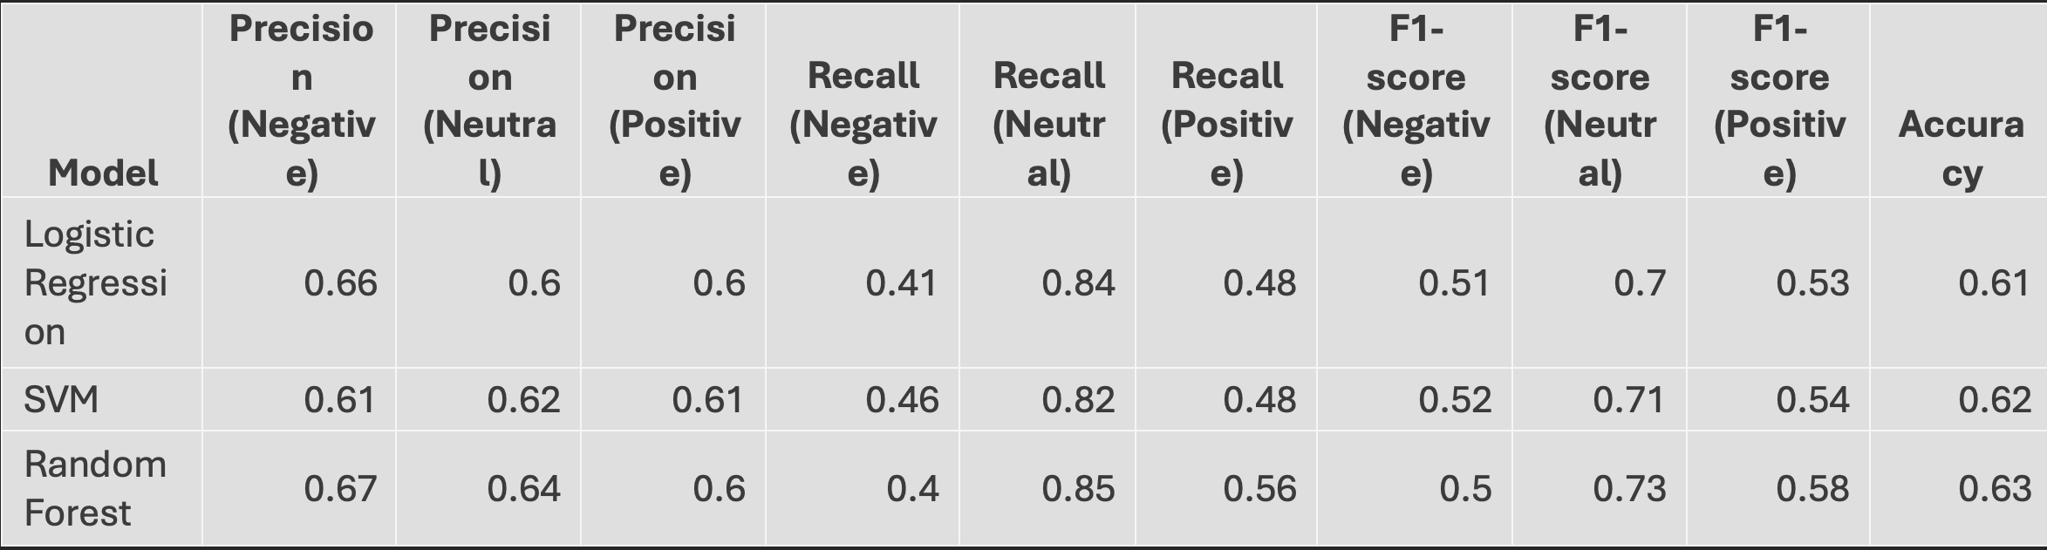
Final Report

Slide 13
Hate Dataset and Model Comparison
Performance Variation Across Classes
The hate dataset is developed to identify the most repeated bad words in Instagram comments. The performance of different models is compared, highlighting the challenges in accurately classifying negative and positive sentiments.

Slide 14
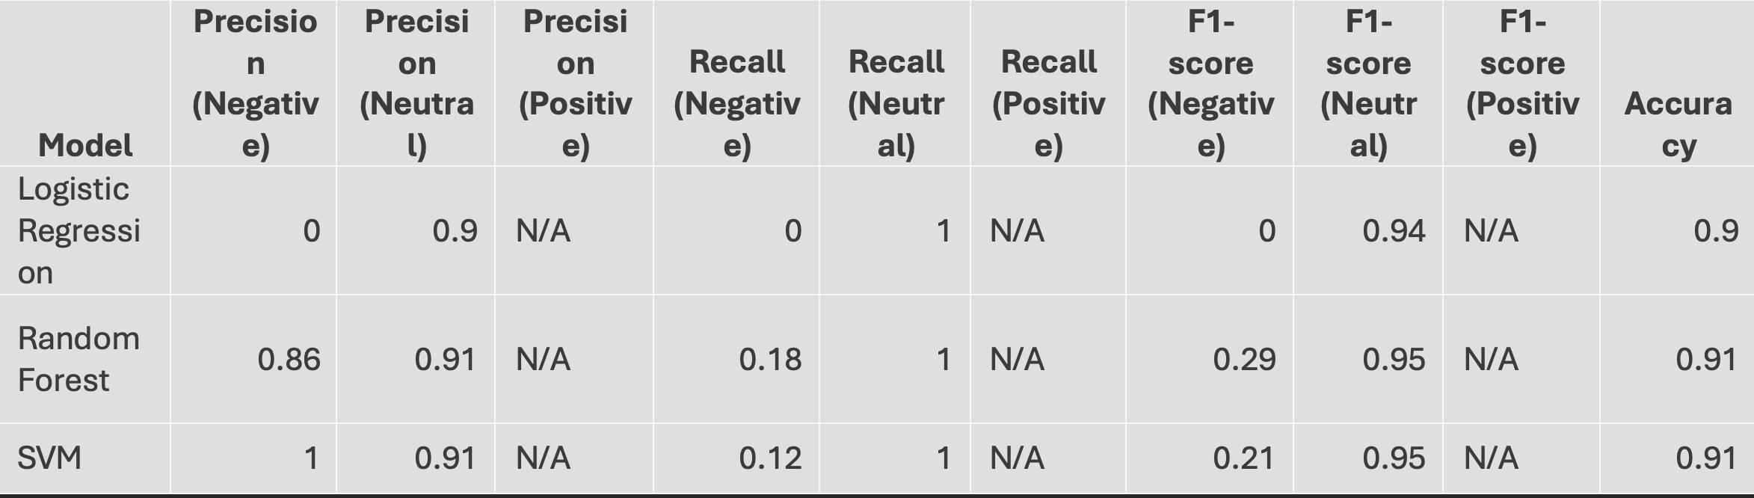
HATE DATASET

Slide 15

Web App Using Streamlit
User Interface
A web app using the trained model for predicting hate or offensive words is created.

Slide 16
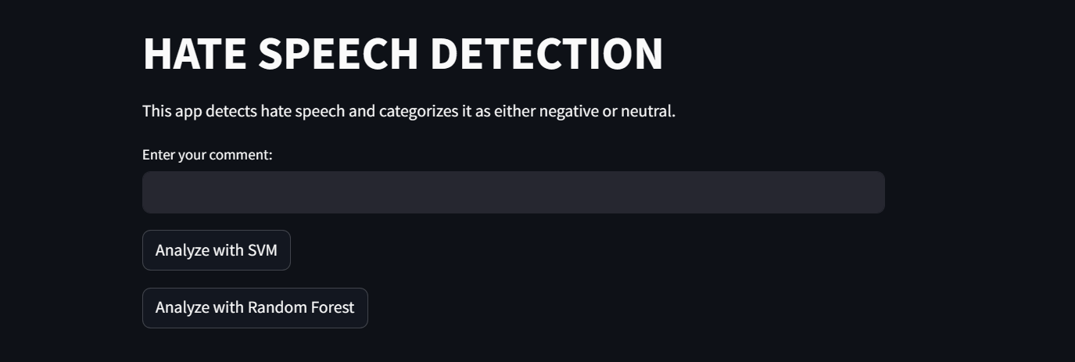
Web App Streamlit UI page

Slide 17

Phishing Links using Regex Expression
The Phishing links are detected using the Regex Expression and red flagged and further analysis.

Slide 18
Conclusion
The presentation concludes with a comparison of different models, insights into their performance, and recommendations for deploying the models in real-world applications to effectively combat phishing and hate speech in Instagram comments.

Slide 19

Thank You

